Slide 1

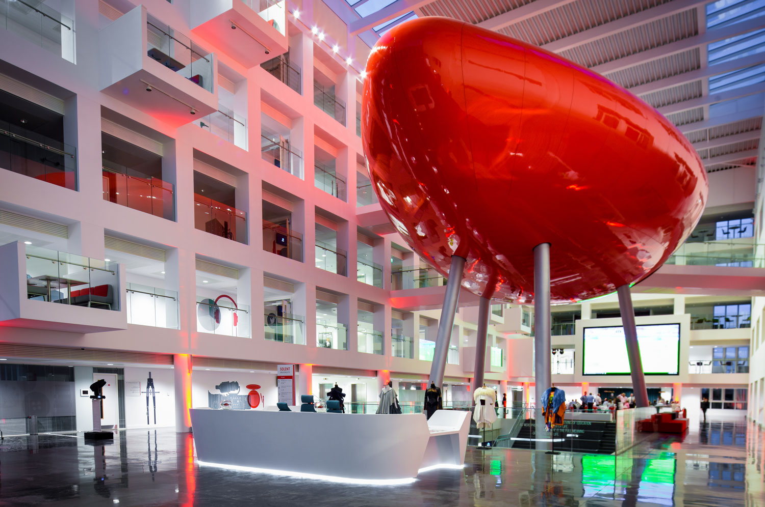


Cybercrime and Digital Forensics (COM622)
Department of Science & Engineering
Solent University
Week 7 Seminar: Discussing the assessment HD image
Dr Daniel Olabanji

Slide 2

Seminar Arrangement
Grouping (Group 4-5) (Already have a group)
Discussion about the HD image

Slide 3
Exercise # 1: Analysis
Using autopsy and properties
Attaching an image
Examine the image
Analysing the image

